Slide 1
For All Who Desire To Live Their Best Life…

Slide 2
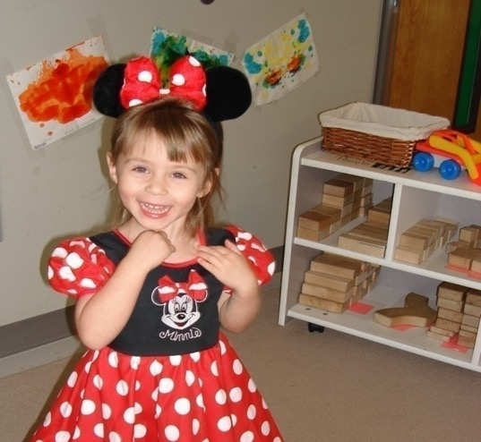
Stuart Finger – CTFO Co-Founder and CEO
Happy CTFO Customer
Father Of A Miracle Daughter
34 Years Experience, Helping People Create Residual Income
Always Seeking The Best!

Slide 3
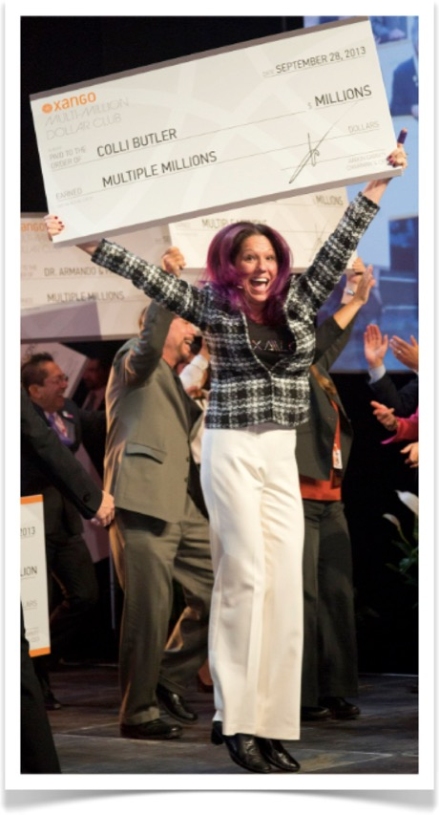
Colli Butler – XanthoMyst 50K Leader
34 Years Industry Experience (21 years with mangosteen)
Multi-Million Dollar Earner (7 million with mangosteen)
$2 Million+ Customers Worldwide
$2 Billion+ in Team Sales
500+ $100K Annual Earners
150+ Million Dollar Earners
30+ Multi-Million Dollar Earners

Slide 4
Your Name – Your Story
Let us Help You Create YOUR Story!

Slide 5
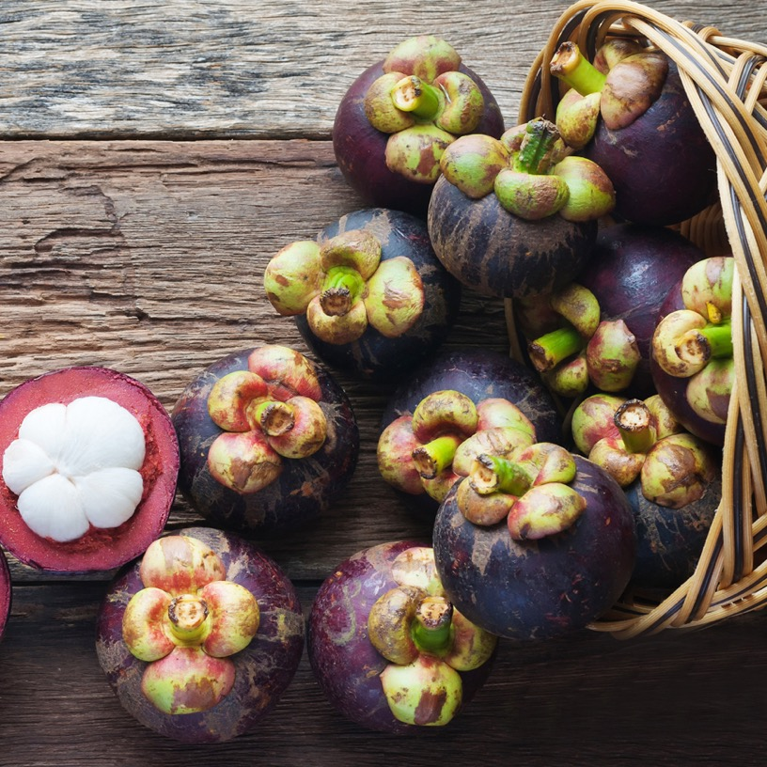
The History of Mangosteen
(Not To Be Confused With Mango)
Scientific Name: Garcinia Mangostana
Grown in Tropical Regions: Thailand, India, Malaysia and the Philippines.
7 to 10 years for the trees to yield fruit.
Mangosteen trees reach up to 75 feet tall.
This tangerine sized fruit consists of Pericarp (the rind), Pulp (the delicious fruit) plus 2 to 3 Seeds.
Folk Medicine Remedies: The rind was dried and made into a tea or a poultice to be used for:
Dehydration, Digestion, Fatigue, Fever, Infections, Pain, Parasites, Skin conditions, Wounds.
And so much more…
Notes:
Need new pic

Slide 6
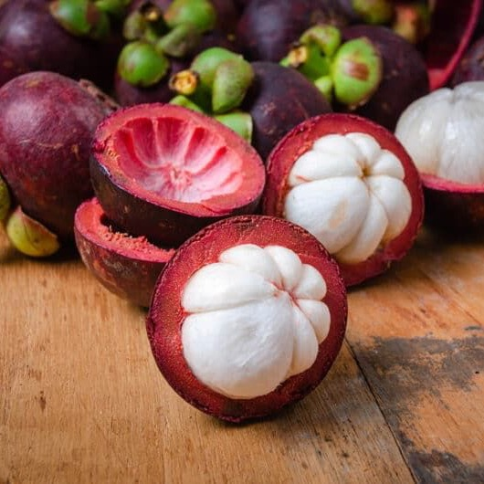
Mangosteen Science
Science has taken centuries to catch up with the wisdom of traditional medicine
Introducing XANTHONES:
The mangosteen contains many active substances, including vitamins, minerals, antioxidants, catechins, polyphenols, polysaccharides, and XANTHONES!
Over 70 xanthone molecules are present in the mangosteen fruit, that’s why it‘s known as the QUEEN of FRUIT and a SUPER FRUIT!
Over the past 20 years, the Xanthones of the Mangosteen have been widely studied and researched around the world.
Notes:
Need new pic

Slide 7
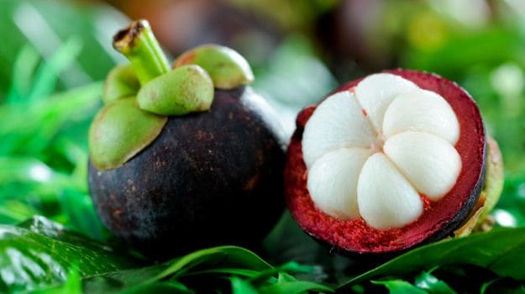
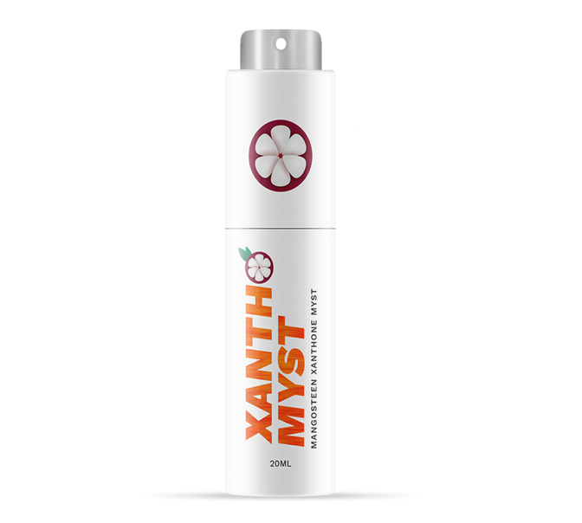
The Problem:
Low Oral Bioavailability
Xanthones are largely insoluble.
The Solution:
Our proprietary 10xPureTM technology extracts and concentrates
Xanthone compounds into a liposomal nano-emulsion for greater Potency, Bioavailability and Faster Delivery.
XanthoMyst’s nano-emulsion droplets are so tiny they are absorbed through the soft tissue of your mouth, so there is very little to swallow.
Bypasses digestive enzymes of the stomach!
Notes:
Need new pic

Slide 8
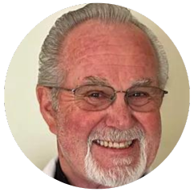
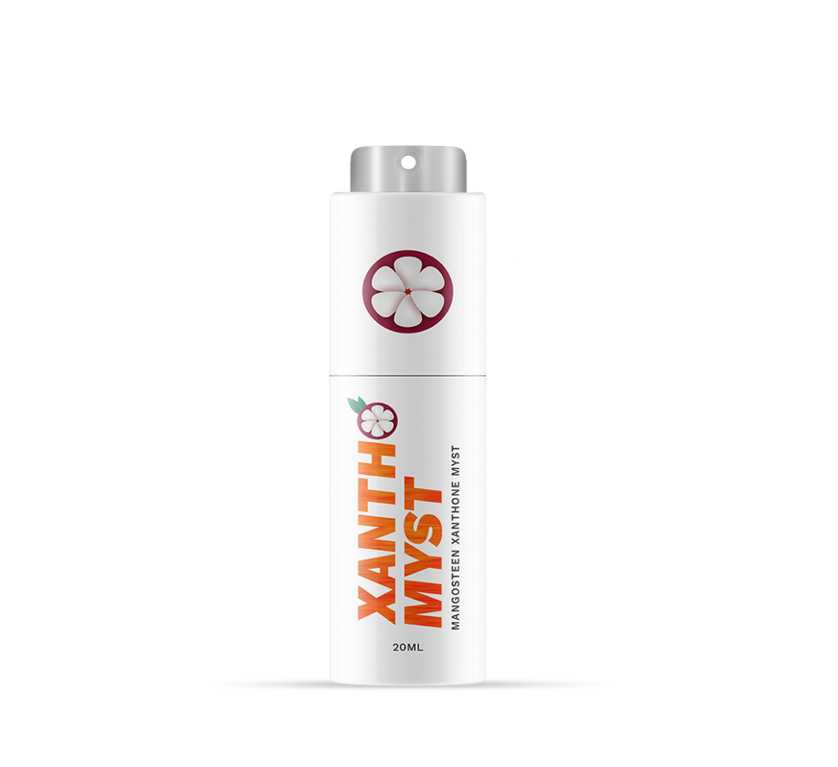
Dr. Templeman Has Said That The Mangosteen Could Impact Every Organ System In Your Body
There are 11 major organ systems in the human body:
The circulatory system (blood to cells)
The lymphatic system (part of the immune system)
The respiratory system (organs for breathing)
The integumentary system (skin, hair, nails)
The endocrine system (regulates hormones)
The gastrointestinal (digestive) system (mouth to south☺)
The urinary (excretory) system (kidney and bladder)
The musculoskeletal system (bones, tendons, ligaments and tissue)
The nervous system (coordinates actions and transmits signals throughout the body)
The reproductive system (organs working together for healthy reproduction)
The immune system (the body’s defense against infections)
Introducing Dr. Fred Templeman, XANTHOMYST™ CONSULTANT
AND
MEDICAL ADVISOR

Slide 9
Life Span Versus Health Span
Life Span has doubled over the last 100 years
Many people are living longer and burdened by chronic disease
Heart disease & diabetes just to name a couple
Health Span is about living longer with better health

Slide 10
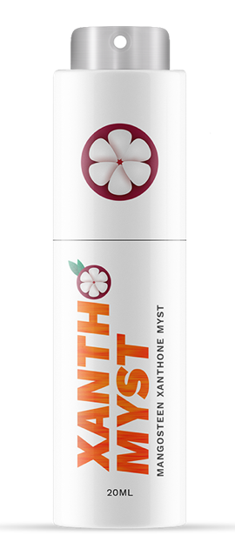
XanthoMyst & Animals!
Our Pets Are Precious!

Slide 11
CTFO Benefits…
Work from home, or anywhere you want.
Smartship saves you up to 20% below wholesale.
Low monthly qualifier.
Unlimited income potential!
Get Paid Weekly.
Work your own hours.
With purchase, your CTFO business is FREE!!!
Create True Residual Income. (The Key!)

Slide 12
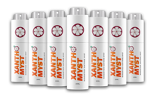
3 Great Ways To Get Started
Best for Business Builders!!!
Most Popular!
good
Better
Best
2 Pack of XanthoMyst
4 Pack of XanthoMyst
7 Pack XanthoMyst
$74.99 each
$72.49 each
$61.42 each
All Prices Are USD
Notes:
Add icons to tops

Slide 13
Your Name Here

Slide 14
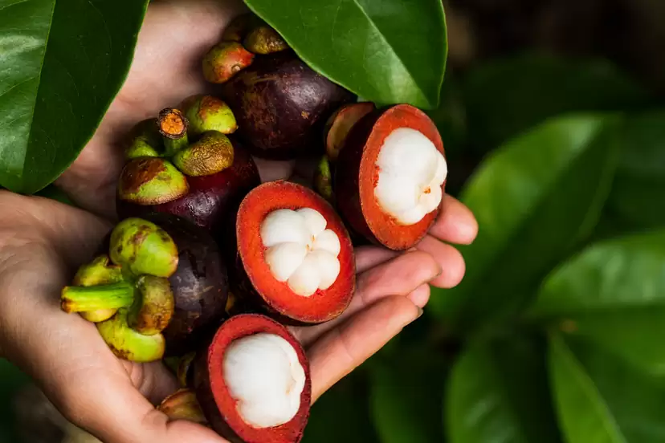
TIMING!
TIMING!
TIMING!

Slide 15
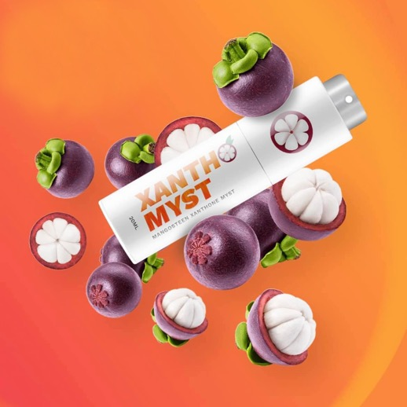
Timing Is Everything!
Are You Ready To Change Your Future Outcome?
Your results may vary based on your efforts.

Slide 16
Thank You, Welcome!
For All Who Desire To Live Their Best Life…

